Slide 1
10th session.
Team and management
Notes:
It is nearly always the most fundamental element. Remind that is people who actually builds the company.

Slide 2
The effective manager (1)
.
Conflict is desirable when it is “Functional”,
as friction is desirable when the conveyor belt moves the pulleys
Notes:
Some management key aspects. We cannot avoid dealing with conflict. Conflict must be managed. A good manager faces conflict in a natural way.

Slide 3
The effective manager (2)
Conflict is functional in a learning environment.
Learning environments exists when there is mutual respect.
Notes:
Conflict is essential to learn. Conflict does not mean bad mood, it means different criteria in positive.

Slide 4
The effective manager (3)
MUTUAL
RESPECT
GOOD PROFESSIONAL MANUAL
Because MUTUAL RESPECT is necessary for teamwork.
The efficient manager, as a team member, is a member who both gives orders and gains the respect from other members.
Notes:
Managing is not commanding, managing is respect. Difference between power, authority and influence (we will see them later).

Slide 5
The effective manager (4)
You are a better manager if people who depends on you are better than you.
Notes:
Managing is humility. The good manager must have a certain dose of “ambitious humility”

Slide 6
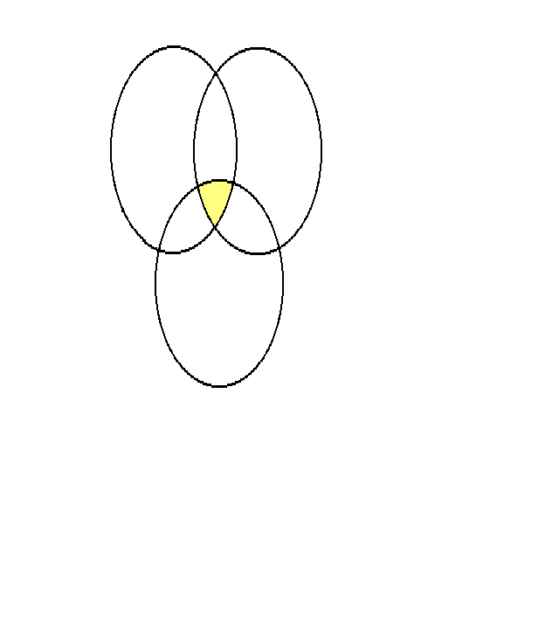
How to be an effective manager (RIPA 1)
AUTHORITY
POWER
AUPOIN
INFLUENCE
SI
AUTHORITY
is the legal right to take decisions.
It is incorporated into the job description of a person, and it is independent of Knowledge, Personality, Education, Connections or Experiences of this person.
Notes:
Describe authority, put examples

Slide 7
How to be an effective manager (RIPA 2)
AUTHORITY
Is the legal right to take decisions.
Authority is given by appointment.
If I am only based on authority, it runs out with time; it end up by generating indifference.
SI
EFFICACY
AUTHORITY
TIME
Notes:
Comment, put examples

Slide 8
How to be an effective manager (RIPA 3)
AUTHORITY
POWER
AUPOIN
INFLUENCE
SI
POWER
is the capacity to give or deny expected rewards.
Other people have power on you because you need them, or because they possess a monopoly on something you need.
While you live, there will be people having power on you.
Notes:
Describe power, put examples

Slide 9
How to be an effective manager (RIPA 4)
POWER
is the capacity to give or deny expected rewards.
Any individual or group who can boycott my decision has power on me.
If I only use power I can generate rebelliousness.
EFFICACY
SI
POWER
TIME
Notes:
Comment this slide

Slide 10
How to be an effective manager (RIPA 5)
AUTHORITY
POWER
AUPOIN
INFLUENCE
SI
INFLUENCE
is the ability to get people performing tasks without having to resort to your authority or power: to get them doing things by their own will.
Notes:
Describe influence, put examples

Slide 11
How to be an effective manager (RIPA 6)
INFLUENCE
It comes from professional and ethical credibility.
Influence remains even after some time, after the manager has ceased to exercise power or to have authority.
Its impact increases with time.
EFFICACY
SI
INFLUENCE
TIME
Notes:
Comment this slide

Slide 12

How to be an effective manager (RIPA 7)
POWER
AUTHORITY
AUPOIN
INFLUENCE
A guarantee for being an effective manager
RIPA =
Regroup
Influence
Power
Authority
Notes:
Comment calmly this slide. We need all these factors appearing at all leadership levels of the organization. Specially at the main levels.

Slide 13

How to be an effective manager (RIPA 8)
AUTHORITY
POWER
AUPOIN
INFLUENCE
AUPOIN
It is the total available capacity and rights you have at a given moment to get the work performed. The configuration of YOUR AU-PO-IN marks the external limits of your capacity to control the situation, if you use all your authority, power and influence you possess.
SI
Notes:
It is very important for the leader figure, specially in a complex organization, with partners and important staff.

Slide 14
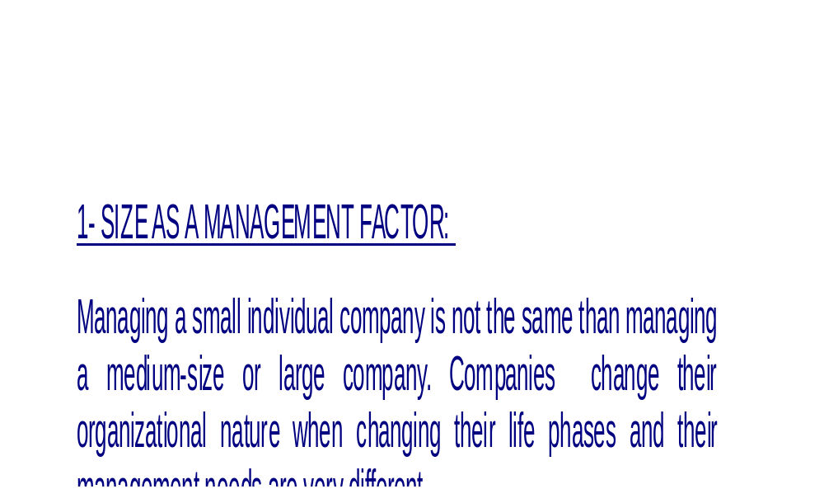
Basic ideas for micromanagement 1
Notes:
Concrete ideas for the case of recently created small or medium companies

Slide 15
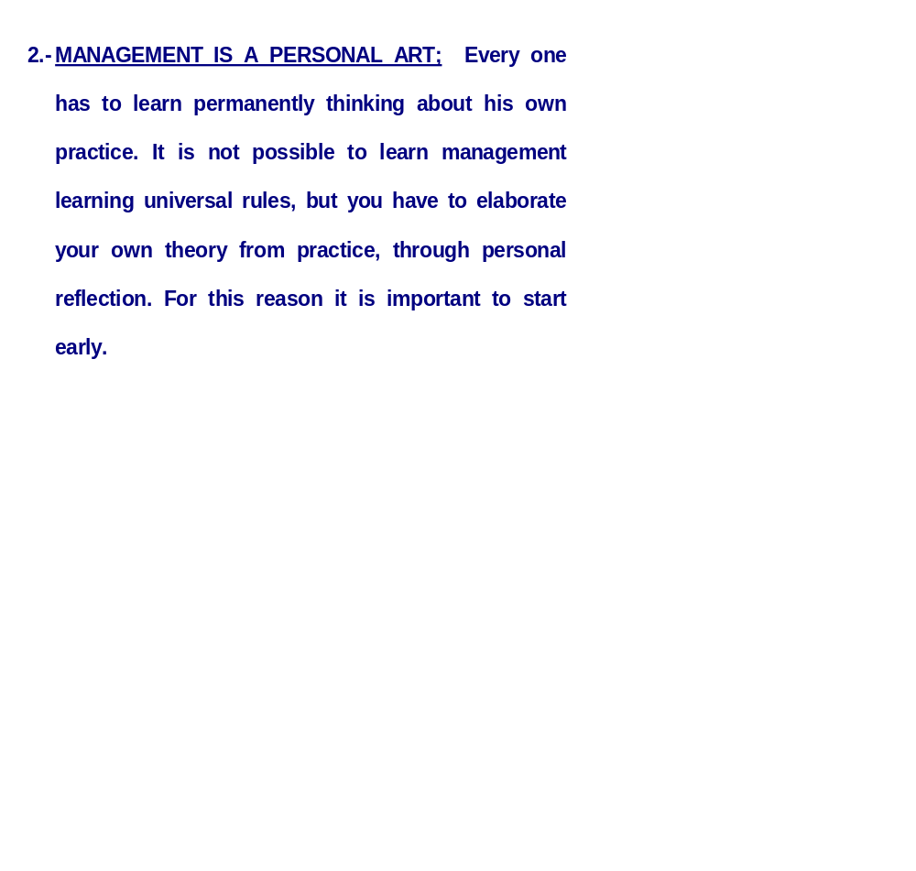
Basic ideas for micromanagement 2
Notes:
Concrete ideas for the case of recently created small or medium companies. Be cautious when believing that we are a multinational.

Slide 16
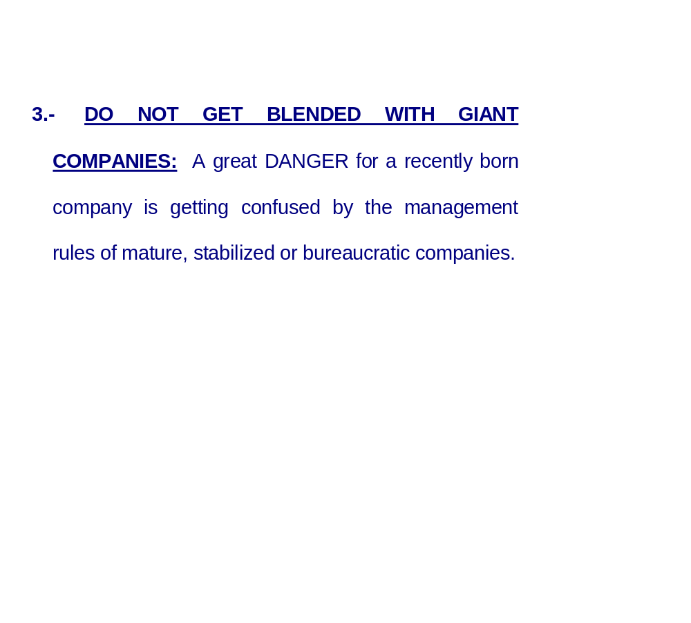
Basic ideas for micromanagement 3
Notes:
Concrete ideas for the case of recently created small or medium companies. Be cautious when believing that we are a multinational.

Slide 17
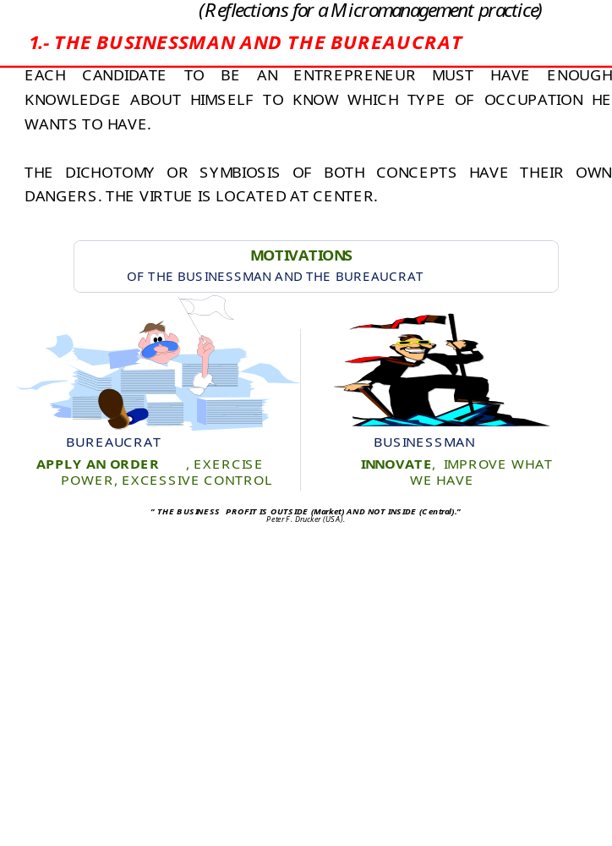
The businessman and the bureaucrat (reflection 1)
Notes:
Concrete ideas for the case of recently created small or medium companies. Important differences between both types.

Slide 18
The businessman and the bureaucrat (reflection 1)
The opportunities of a company are outside itself (in the market, with the customer), not inside (in internal themes or structure).
Adapted from Peter F. Drucker
Notes:
Concrete ideas for the case of recently created small or medium companies. Important differences between both types.

Slide 19
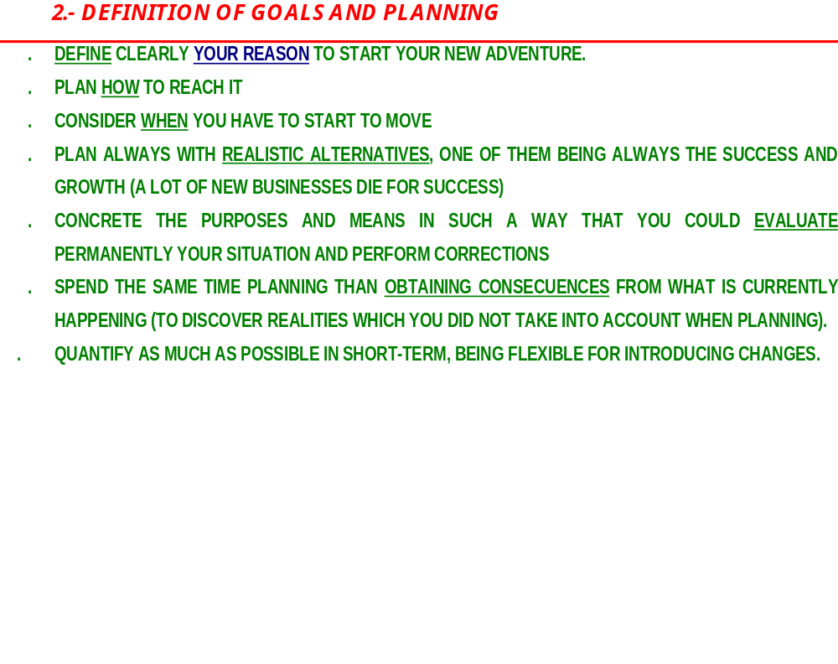
Definition of goals and planning (reflection 2)
Notes:
Concrete ideas for the case of recently created small or medium companies. Pay attention on what you need.

Slide 20
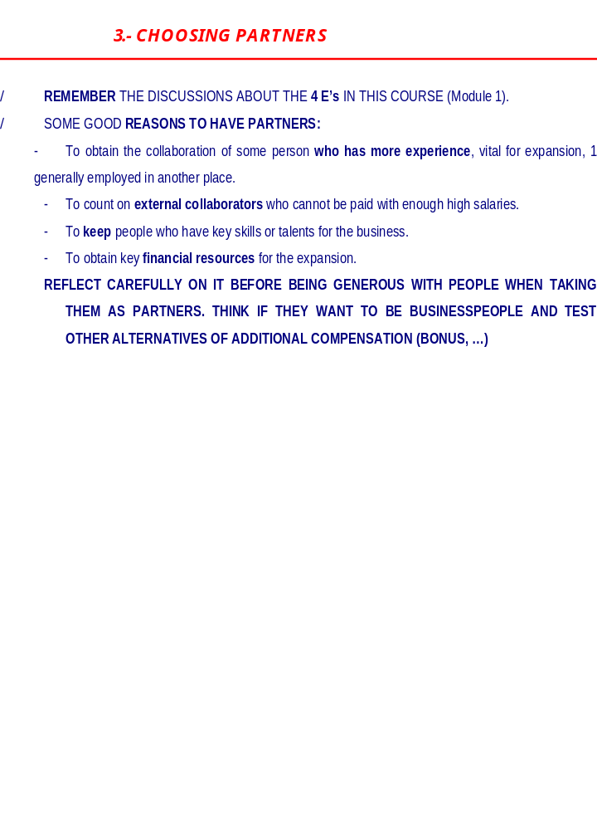
Choosing partners (reflection 3)
Notes:
Concrete ideas for the case of recently created small or medium companies. Partners are very important, put examples.

Slide 21
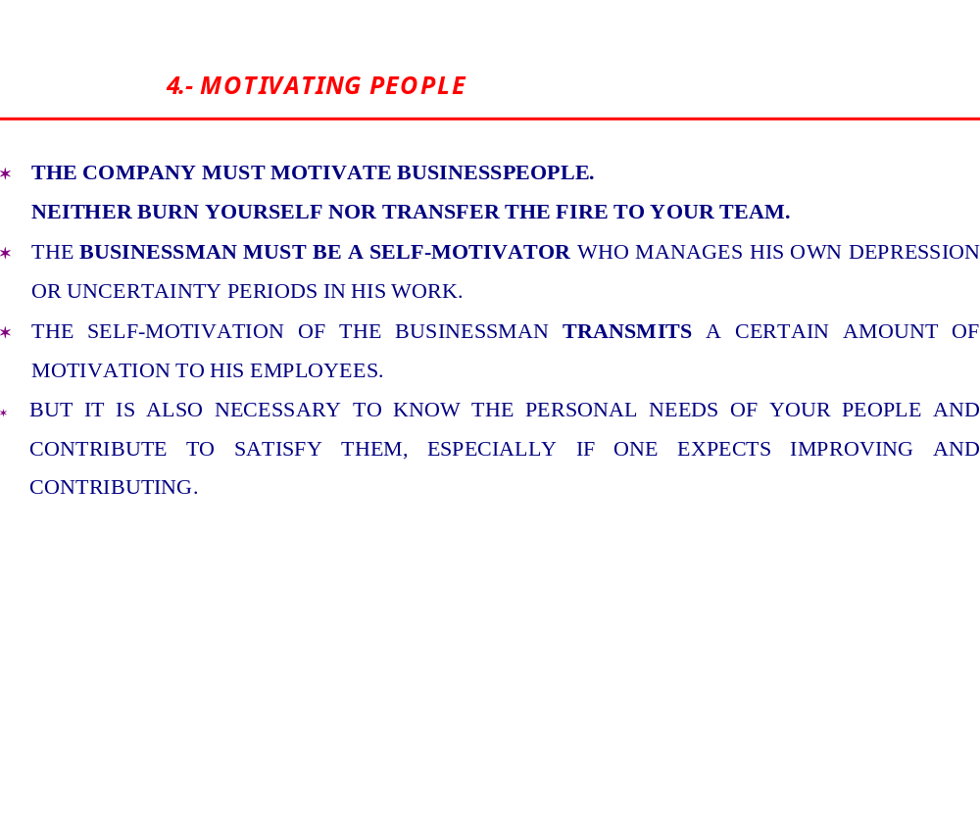
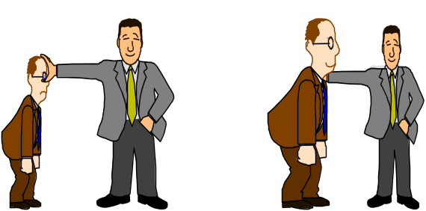
Motivating people (reflection 4)
Notes:
Concrete ideas for the case of recently created small or medium companies. Neither burn yourself nor transfer the fire.

Slide 22
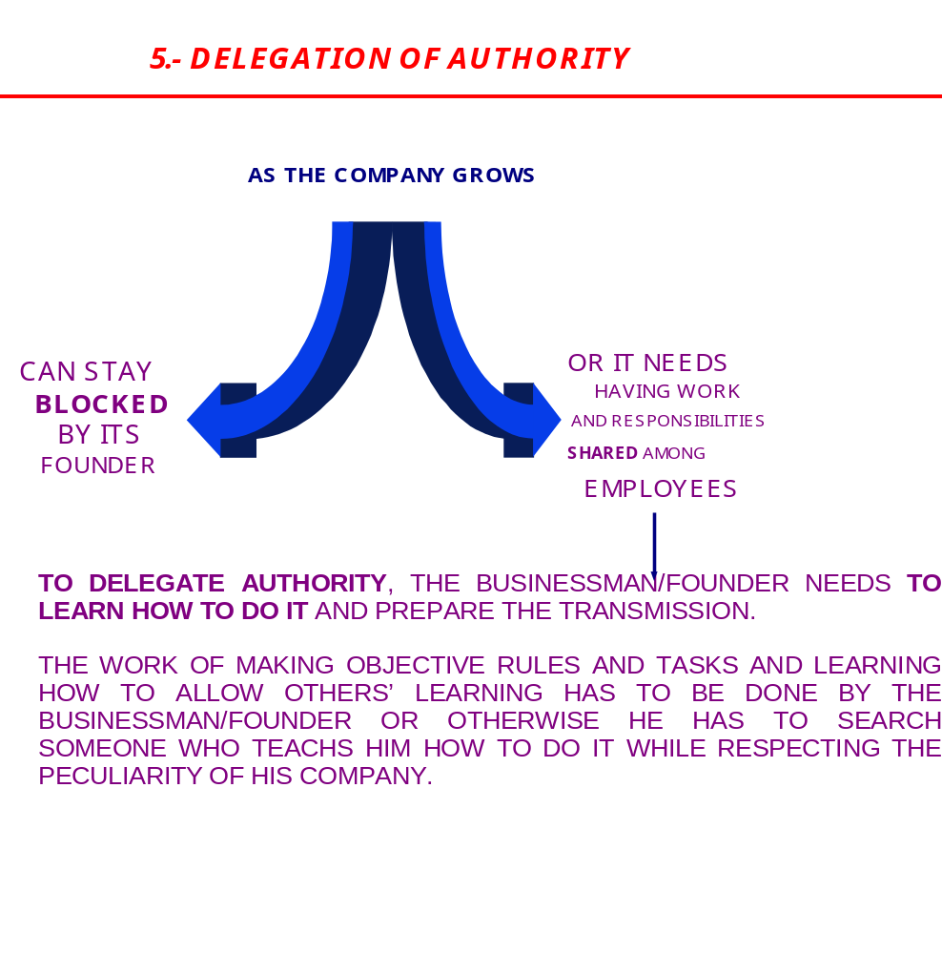
Delegation of authority (reflection 5)
Notes:
Concrete ideas for the case of recently created small or medium companies. Delegate or die.

Slide 23
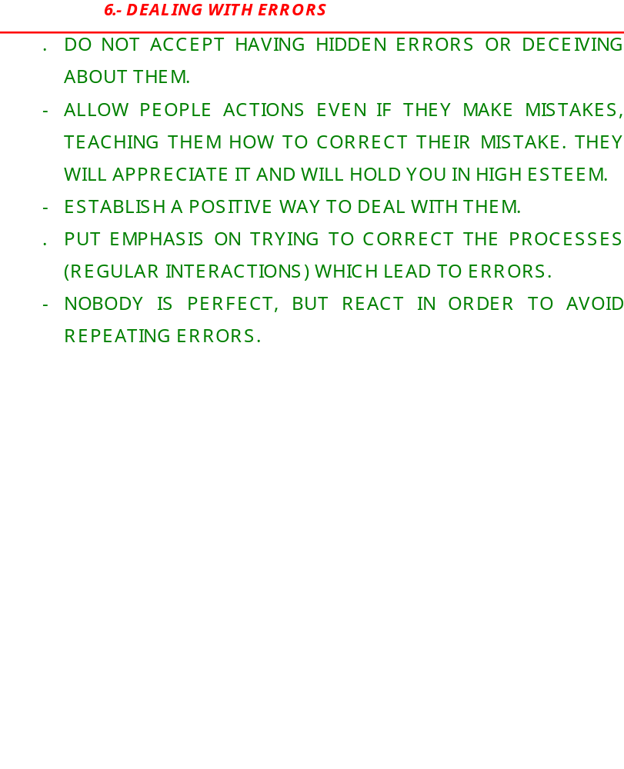
Dealing with errors (reflection 6)
Notes:
Concrete ideas for the case of recently created small or medium companies. Learn and provide learning from errors.

Slide 24
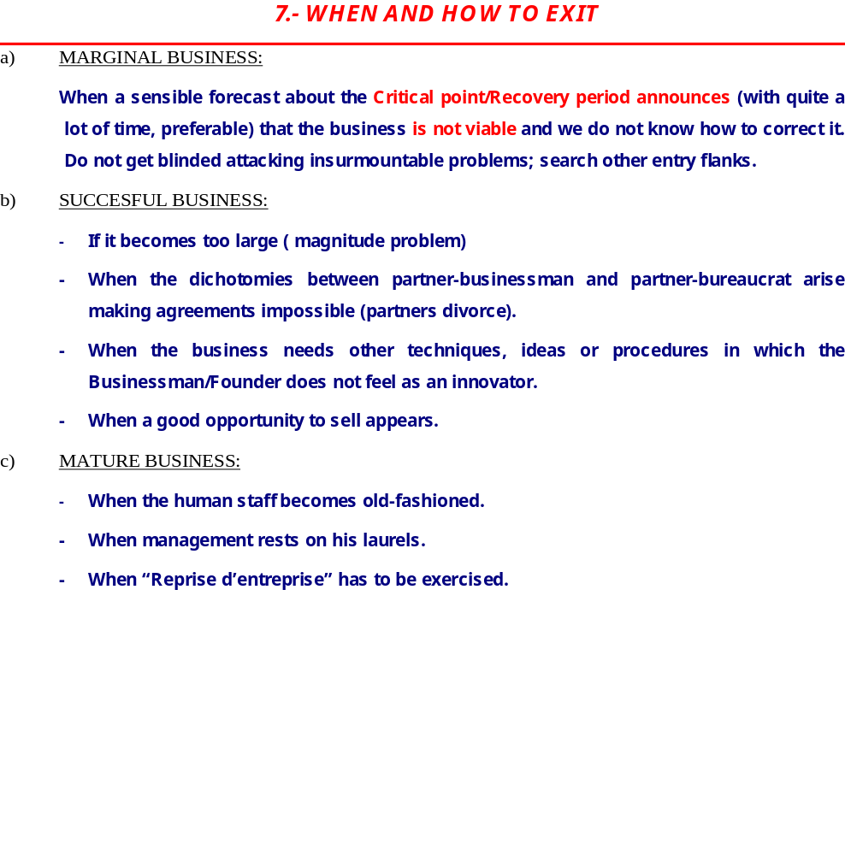
When and how to exit (reflection 7)
Notes:
Concrete ideas for the case of recently created small or medium companies. How to exit.

Slide 25


Growth and evolution of an organization (I. Adizes).
12 4
EEeE
BEHAVIOR
1234
EEEE
Stable
Maturity
2 4
eEeE
Aristocracy
123
EEEe
12
EEee
Prime
0204
-E- e
23
eEEe
Divorce
Early Bureaucracy
3
eeEe
1 3
EeEe
Adolescence
0200
-E - -
Founder trap
1
Eeee
Go-go
Bureaucracy
Infant
mortality
3
eeEe
Infancy
Death
Aborted idea
0000
- - - -
Courtship
YEARS
Notes:
Comment the life cycles of an organization coming back to the 4 E’s. Remind the profiles of each team member and remind the need of balance among the different E’s to reach maturity. We must prepare a plan which allows going from Go-go to Maturity.

